Slide 1


Day 2: Lists, Dictionaries, and CSV Import with Pandas Michael Ames
Wake Forest
School of Business
_______
Bootcamp Day 2

Slide 2
Agenda
Lists
Dictionaries
Pandas
"Statistics is the grammar of science." - Karl Pearson (1857-1936) was an influential English mathematician. He is widely regarded as the founder of modern statistics. Pearson developed various statistical methods and concepts, including the correlation coefficient and chi-square test.

Slide 3
Introduction to Lists
A list is a collection of items that can store multiple values.
Lists are ordered and mutable, allowing you to modify, add, and remove elements.
Creating Lists
Lists can be created by enclosing comma-separated values within square brackets: my_list = [value1, value2, value3].
Elements in a list can be of any data type, such as integers, strings, or even other lists.
Accessing Elements in a List
Each element in a list has an index, starting from 0 for the first element.
Elements can be accessed using square bracket notation: my_list[index].
Negative indices can be used to access elements from the end of the list: my_list[-1] refers to the last element.
fruits = ["apple", "banana", "orange", "grape"]
# Accessing elements
print(fruits[0]) # Output: "apple"
print(fruits[-1]) # Output: "grape"

Slide 4
Why Lists?
Lists are a fundamental data structure in Python :
Lists allow us to store and manage multiple values in a single variable.
They provide flexibility in adding, removing, and updating elements as needed.
Lists are versatile and can hold values of different data types, including numbers, strings, and even other lists.
They maintain the order of elements, allowing us to access and manipulate data based on indices.
Lists are essential for solving problems that involve collections of related data.
With lists, we can perform operations like concatenation, repetition, and membership testing.
They serve as building blocks for more complex data structures and algorithms.
Mastering lists allows us to write efficient, organized, and scalable code.
0
1
2
ex_list =
Item 1 | Item 2 | Item 3 | … | Item N

Slide 5
Modifying Lists
Append & Insert
my_list =
Item 1 | Item 2 | Item 3
The append() function is used to add an element to the end of a list:
my_list.append(“new_item”).
The insert() function is used to add an element at a specific position in the list:
my_list.insert(index, element)
my_list.insert(1, “new_element”)
Item 1 | Item 2 | Item 3 | new_item
Item 1 | new_element | Item 2 | Item 3 | new_item

Slide 6
Modifying Lists
Updating
Updating Elements
Elements in a list can be updated by assigning new values to specific indices:
my_list[index] = new_value.
my_list[0] = “new_value”
my_list =
Item 1 | Item 2 | Item 3
new_value | Item 2 | Item 3

Slide 7
Modifying Lists
remove() and pop()
Removing Elements
The remove() function removes the first occurrence of a specified element from the list:
my_list.remove(element)
my_list.remove(“Item 1”).
The pop() function removes and returns the element at a specified index.
If no index is provided, it removes the last element:
my_list.pop(index)
my_list.pop(0)
my_list =
Item 1 | Item 2 | Item 3
Item 2 | Item 3
Item 3

Slide 8
Example of Lists
# Adding elements
numbers = [1, 2, 3]
numbers.append(4) # numbers: [1, 2, 3, 4]
numbers.insert(2, 5) # numbers: [1, 2, 5, 3, 4]
# Updating elements
numbers[0] = 10 # numbers: [10, 2, 5, 3, 4]
# Removing elements
numbers.remove(5) # numbers: [10, 2, 3, 4]
popped_element = numbers.pop() # popped_element: 4, numbers: [10, 2, 3]

Slide 9

Open: 2.1 Lists pt 1
5 Minutes

Slide 10
List Operations
Concatenation
The + operator is used to concatenate two or more lists: new_list = list1 + list2.
Repetition
The * operator is used to repeat a list a certain number of times: new_list = list * n.
Membership Testing
The in and not in operators are used to check if an element is present in a list: element in list or element not in list.
Length of a List
The len() function is used to find the number of elements in a list: length = len(list).

Slide 11
List Operations
# Concatenation
fruits1 = ["apple", "banana"]
fruits2 = ["orange", "grape"]
all_fruits = fruits1 + fruits2
# all_fruits: ["apple", "banana", "orange", "grape"]
# Repetition
repeated_fruits = fruits1 * 3
# repeated_fruits: ["apple", "banana", "apple", "banana", "apple", "banana"]
# Membership Testing
if "apple" in fruits1:
print("Apple is present in the list.")
if "kiwi" not in fruits1:
print("Kiwi is not present in the list.")
# Length of a List
count = len(fruits1) # count: 2

Slide 12
List Operations
sort()
sort() Method
The sort() method is used to sort the elements of a list in ascending order.
It modifies the original list in-place and does not return a new list.
Example:
numbers = [5, 2, 8, 1, 3]
numbers.sort()
print(numbers) # Output: [1, 2, 3, 5, 8]

Slide 13
List Operations
reverse()
reverse() Method
The reverse() method is used to reverse the order of elements in a list.
It modifies the original list in-place and does not return a new list.
Example:
fruits = ['apple', 'banana', 'cherry']
fruits.reverse()
print(fruits) # Output: ['cherry', 'banana', 'apple']

Slide 14
List Operations
count()
count() Method
The count() method returns the number of occurrences of a specific element in a list.
It takes an element as an argument and returns an integer value.
Example:
numbers = [1, 2, 3, 2, 4, 2, 5]
count_2 = numbers.count(2)
print(count_2) # Output: 3

Slide 15
Open: 2.2 Lists pt2
5 Minutes

Slide 16
Dictionaries
key-value pairs
Introduction to Dictionaries
Dictionaries are another fundamental data type in Python.
Unlike lists, which use an index to access elements, dictionaries use keys to access values.
Dictionaries are also known as associative arrays or hash maps in other programming languages.
Definition and Characteristics of Dictionaries
A dictionary is an unordered collection of key-value pairs.
Each key in a dictionary must be unique, and it is used to access its associated value.
Dictionaries are enclosed in curly braces {} and consist of comma-separated key-value pairs.
Keys and values can be of any data type, such as strings, numbers, or even other dictionaries.
Creating Dictionaries and Accessing Values Using Keys
Dictionaries can be created using the {} notation or the dict() constructor.
To access values in a dictionary, we use the associated key in square brackets [].

Slide 17
Dictionaries
# Creating a dictionary
student = {"name": "John", "age": 20, "grade": "A"}
# Accessing values using keys
print(student["name"]) # Output: John
print(student["age"]) # Output: 20
print(student["grade"]) # Output: A
Dictionaries are important in Python because they provide a powerful way to store and retrieve data using key-value pairs. Here are a few reasons why dictionaries are important:
Efficient Data Retrieval: Dictionaries allow for fast and efficient retrieval of values based on their associated keys.
Flexible Data Structure: Dictionaries are highly flexible and can hold a variety of data types as both keys and values.
Easy Data Organization: Dictionaries provide a convenient way to organize and manage data..
Key-Value Mapping: Dictionaries establish a mapping relationship between keys and values, allowing you to represent associations or relationships between different pieces of information.
Efficient Data Manipulation: Dictionaries support a wide range of operations, including adding, updating, and deleting key-value pairs.

Slide 18
Dictionaries
Adding and Updating Key-Value Pairs
Dictionaries allow us to add new key-value pairs or update the values of existing keys.
We can assign values to new or existing keys using the assignment operator =
# Creating an empty dictionary
student = {}
# Adding a new key-value pair
student["name"] = "John"
student["age"] = 20
# Updating the value of an existing key
student["age"] = 21
student
{'name': 'John', 'age': 21}

Slide 19
Dictionaries
Is a key in a dictionary?
Membership Testing
Dictionaries provide membership testing operations to check if a key is present in the dictionary.
We can use the in and not in operators to perform membership testing.
# Checking if a key is present in a dictionary
student = {"name": "John", "age": 20, "grade": "A"}
if "name" in student:
print("Name is present in the dictionary.")
if "city" not in student:
print("City is not present in the dictionary.")

Slide 20
Dictionaries
keys, values and items
Accessing Keys, Values, and Items
Dictionaries provide methods to retrieve keys, values, and key-value pairs.
We can use the keys(), values(), and items() methods to access dictionary elements.
# Accessing keys, values, and items of a dictionary
student = {"name": "John", "age": 20, "grade": "A"}
keys = student.keys()
values = student.values()
items = student.items()
print("Keys:", keys)
print("Values:", values)
print("Items:", items)
Keys: dict_keys(['name', 'age', 'grade']) Values: dict_values(['John', 20, 'A’])
Items: dict_items([('name', 'John’),
('age', 20), ('grade', 'A')])

Slide 21
Open: 2.3 Dictionaries
5 Minutes

Slide 22

Pandas
"While pandas are known for their cuddly appearance, in the world of data analysis, Pandas is an indispensable tool for manipulating and analyzing structured data." - Unknown

Slide 23
What is Pandas
Pandas is a Python package providing fast, flexible, and expressive data structures designed to make working with “relational” or “tabular” data both easy and intuitive. It aims to be the fundamental high-level building block for doing practical, real-world data analysis in Python
But what is it?
it is the package that lets you work and analyze tables also known as data frames.
Rows and Columns – like an excel spreadsheet without cell-based formulas
Series vs. Data Frames - Series (1-dimensional) and Data Frame (2-dimensional)
Data types – integer, float, string, datetime, logical
Methods – mean, min, max, sort_values, group_by, and hundreds of others.

Slide 24
Pandas
A DataFrame also known as a Table
A “rectangular” table (rows, and columns).
Each column can have different datatypes (string, integer, float, etc)
Row index, basically a sequential number that allows us to directly select rows
Column index, basically positional or named column, allows us to select what columns of data
df.loc[row_indexer, column_indexer]
Index | Column1 | Column2 | … | ColumnN
0
1
…
N
Row
Column

Slide 25
Pandas
How do I get data into a Panda’s Data Frame?
I use the following import convention throughout the course, this is step 1. load the library
import pandas as pd
Reading data from a file like a CSV (comma delimited file) or excel is simple, this is step 2. import data
df = pd.read_csv(“myfile.csv”)
df = pd.read_excel(“myfile.xlsx”, sheet_name = “AAPL”)
Reading CSV files things to know.
Panda’s starts with tokenizing and parsing the file based on the delimiter, for CSV this defaults to a comma
Panda’s default is header=0, which means the first record be treated as column names.
Pandas will then try to infer the type automatically.
You can explicitly define types of the columns using dtype parameter
Reading Excel files things to Know
Panda’s starts with tokenizing and parsing the Worksheet
Panda’s default is header=0, which means the first record be treated as column names.
Pandas will then try to infer the type automatically based on what you set in Excel
You can explicitly define types of the columns using dtype parameter

Slide 26
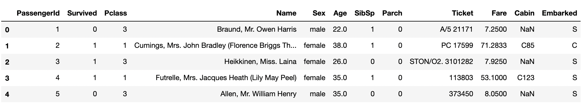
Pandas
Getting data into a Data Frame
Pandas provides the read_csv() function to read data stored as a csv file into a pandas DataFrame. pandas supports many different file formats or data sources out of the box (csv, excel, sql, json, parquet, …), each of them with the prefix read_*. Always eyeball the data after reading into pandas.
Eyeball the First 5 rows of data, use df.head() method, .head(10) returns 10 records
Eyevall the Last 5 rows of data, use df.tail() method, .tail(10) returns 10 records
titanic = pd.read_csv("https://raw.githubusercontent.com/datasciencedojo/datasets/master/titanic.csv")
titanic.head()

Slide 27
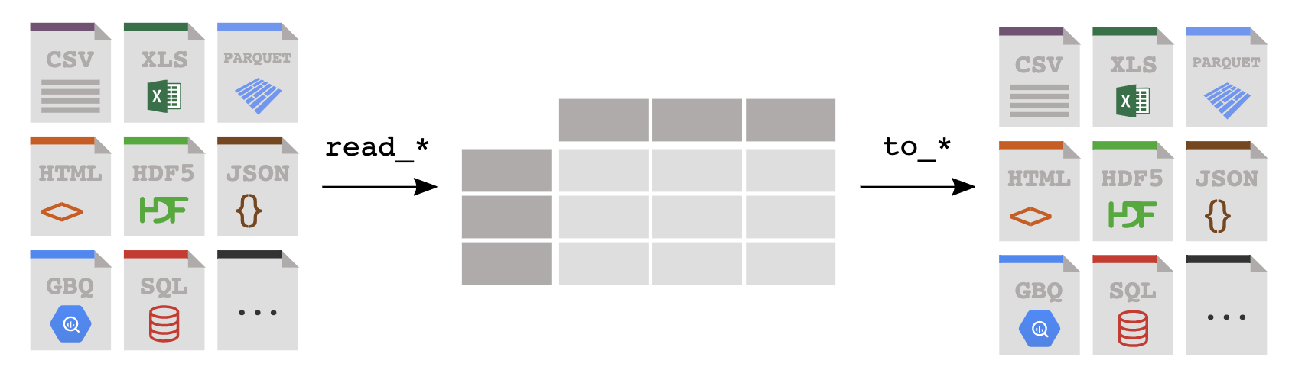
Pandas
Reading & Writing Data
Reading: read_*
df = pd.read_csv(‘myfile.csv’)
Writing : to_*
df.to_excel(‘myfile.xlsx’)
You can read data from a file or database into a Pandas DataFrame, and you can write from a DataFrame to a file or a database, the key is to get your data into Pandas!

Slide 28
Pandas
Data Types
To add to our confusion, Pandas has their own “data types” which are essentially extensions of Python types and NumPy data types. The table below details these.
Converting between data types in Pandas is straight forward
Use astype() to force an appropriate data type like string to int, string to float
Use pandas' functions such as to_numeric() or to_datetime()
when formats are involved $10,200.23, 8May2023
Pandas dtype | Python type | Usage
object | str or mixed | Text or mixed numeric and non-numeric values
int64 | int | Integer numbers
float64 | float | Floating point numbers
bool | bool | True/False values
datetime64 | datetime | Date and time values
timedelta[ns] | NA | Differences between two datetimes
category | NA | Finite list of text values

Slide 29
Pandas
Properties
df.shape – returns the number of rows and columns of a data frame
You can reference df.shape[0] to return number of records.
df.columns – returns a “list” of columns
You can change column names by updating the list OR using the rename function
df.dtypes – returns a Series with the data type of each column
Use this to check the assigned data types
df.index – returns the range index object, details on the index, not super useful.
df.info() – returns all the above and more about the dataframe.
Use this to get details about your data frame.

Slide 30
Pandas
What is a Series?
Each column in a data frame is a “series”
Think of it as a single column DataFrame
newSeries = df[“Column1”]
Series
Index | Column1 | Column2 | ColumnN
0
1
…
N
Index | Column1
0
1
…
N
=
> type(df[”Column1"])
% pandas.core.series.Series
https://pandas.pydata.org/pandas-docs/stable/reference/api/pandas.Series.html

Slide 31
Pandas
How do I “select specific columns”
Select specific ”columns” = [[ ]] – “bracket bracket”
newDataFrame = df[[ ”Column1”, “Column3”]]
DataFrame
Index | Column1 | Column2 | ColumnN
0
1
…
N
Index | Column1 | Column3
0
1
…
N
=
> type(df[[”Column1”]])
% pandas.core.frame.DataFrame
https://pandas.pydata.org/pandas-docs/stable/reference/api/pandas.DataFframe.html

Slide 32
Pandas
How do I “select specific rows?” ~ DataFrame Filtering 1st way
Select specific ”rows” = either df[df..] or df.loc[df..]
queryResult = df[df[“Column1] == “value”]
queryResult = df.loc[df[“Column1] == “value”]
DataFrame
Index | Column1 | Column2 | ColumnN
0
1
…
N
Index | Column1 | Column3
0
1
…
M
=
https://towardsdatascience.com/filtering-data-frames-in-pandas-b570b1f834b9

Slide 33
Pandas
Conditional Operators for Data Frame based Filtering
Pandas supports the common operator stuff
equal to: df[df[”column”] == “some_value”]
not equal to: df[df[”column”] != “some_value”]
greater than: df[df[”column”] > some_number ] (>,>=, <, M=)
In a list df[df[”column”].isin(a_list)]
use the squiggly “~” for not in a list, df[~df[”column”].isin(a_list)]
Multi-Conditions and = & and or = |)
AND: df[ (df[“column1” != “value”) & (df[“column2”] > some_nbr)]
OR : df[ (df[“column1” != “value”) | (df[“column2”] > some_nbr)]

Slide 34
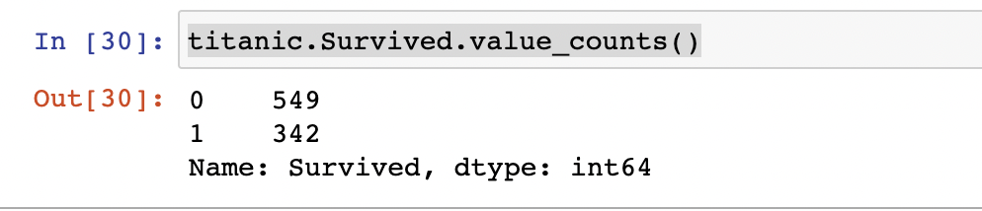
Pandas
Other Useful functions
df[column].value_counts() – returns a frequency count of the column
df[column].value_counts(normalize=True) returns the % of total for the column
df.info() – concise summary of dataframe
df.describe() – provides summary statistics of your DataFrame’s numeric columns
<class 'pandas.core.frame.DataFrame'>
RangeIndex: 3333 entries, 0 to 3332
Data columns (total 21 columns):
state 3333 non-null object
account_length 3333 non-null int64
area_code 3333 non-null int64
phone 3333 non-null object
 | count | mean | std | min | 0.25 | 0.5 | 0.75 | max
account_length | 3333 | 101.064806 | 39.822106 | 1 | 74 | 101 | 127 | 243
area_code | 3333 | 437.182418 | 42.37129 | 408 | 408 | 415 | 510 | 510
vmail_message | 3333 | 8.09901 | 13.688365 | 0 | 0 | 0 | 20 | 51

Slide 35
Pandas
.value_counts()
The .value_counts() method is typically applied to a Series or a column in a DataFrame.
It counts the occurrences of each unique value in the Series and returns the result as a new Series.
The resulting Series is sorted in descending order by default, with the most frequent values appearing first.
It is useful for understanding the distribution and frequency of values in a column.
# Count the occurrences of each category
category_counts = df['Category'].value_counts()
# Display the result
print(category_counts)
A 4
B 4
C 3
Name: Category, dtype: int64

Slide 36
Sorting DataFrames in Pandas
.sort_values()
The sort_values() method in Pandas is used to sort a DataFrame or Series by one or more columns.
Syntax: df.sort_values(by, axis=0, ascending=True, inplace=False)
by: Specifies the column(s) to sort by. It can be a single column name or a list of column names.
[column1, column2]
axis: Specifies the axis along which to sort. 0 for sorting rows (default) and 1 for sorting columns.
ascending: Specifies the sorting order. True for ascending order (default) and False for descending order.
ascending=True
inplace: Specifies whether to modify the DataFrame/Series in-place or return a new sorted object.
Default is False, The DataFrame or Series is not modified unless inplace=True is specified.
Sorting can be done based on numerical values, strings, dates, or any other comparable data type.

Slide 37
Sorting DataFrames in Pandas
.sort_values()
# Sorting a DataFrame by a single column
df.sort_values(by='column_name', ascending=True, inplace=True)
# Sorting a DataFrame by multiple columns
df.sort_values(by=['column1', 'column2'], ascending=[True, False], inplace=True)
# Sorting a Series in descending order
series.sort_values(ascending=False, inplace=True)

Slide 38
Open: 2.4 Pandas 101
5 Minutes

Slide 39

Practice
Day 2 Practice

Slide 40


